Slide 1

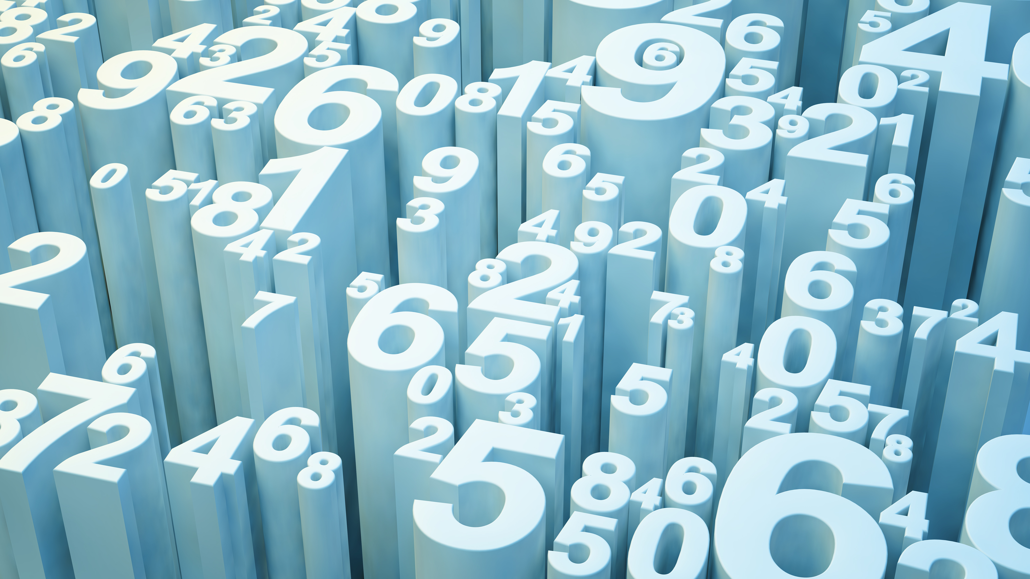

Inverted Index and Boolean Queries
Ali Youssef Solh 202470101

Slide 2
Statistics After Building Inverted Index of Coursera Corpus
Number Of Distinct Words: 149,807
Number OF Documents : 10 823 HTML FILE
Average Number Of Distinct Words/doc: 858.99 words
Size of Inverted Index : 6844872 Bytes = 6844.872 KB
Size Of The Collection : 3,834,382,523 Bytes = 3.834382523 GB
Average Document Frequency : 29.338272681821568
Most Frequent Word : learn

Slide 3
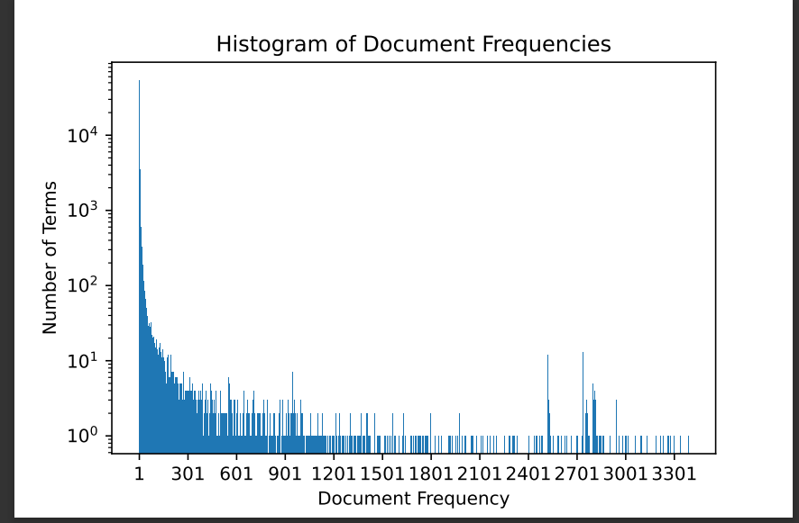
Histogram of Document Frequencies

Slide 4
Efficient Intersection Algorithms
Skip lists (not always efficient in comparison with linear one)
Intersection Algorithm using Hash Sets
Code in python ( O(n) complexity)
def intersection(lst1, lst2):
temp = set(lst2)
lst3 = [value for value in lst1 if value in temp]
return lst3

Slide 5
Comparing The Two Algorithms
Linear Algorithm Rate (elements per second): 5,879,415.14
Efficient Algorithm Rate (elements per second): 16,807,469.8369
Rate for Reading 26 lists from Disk (elements per second): 43,091,683.40588
Programming Language: Python
Laptop specs:
Core-i7 10th generation
16 RAMS
1 Terra NVME

Slide 6
Queries
Extension of Intersection Algorithm:
Implement OR function = concatenation – efficient intersection algorithm
Implement NOT function = removing from current result list all documents containing negated item
Once query string received , split it to get the operators and terms , and start operate by performing one of the implemented Boolean function on the terms and repeat until the list of operators become empty (all processed)
First Query : bachelor AND learn AND link AND certificateearn
Second Query: googl OR coursera AND best
Third Query: london AND abroad AND internship NOT slow
Fourth Query: master OR coach OR strength OR influenc
Fifth Query : spread OR robust AND qualiti NOT stress
Sixth Query : studi AND facebook AND group OR member
Average Runtime Of queries: 0.0056 seconds

Slide 7
Thank You!
For any inquiries , reply by a comment to the post on moodle

